Slide 1
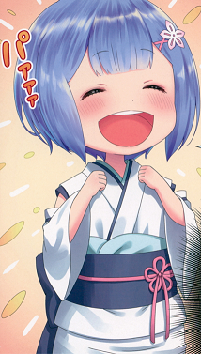
Hello everyone

Slide 2
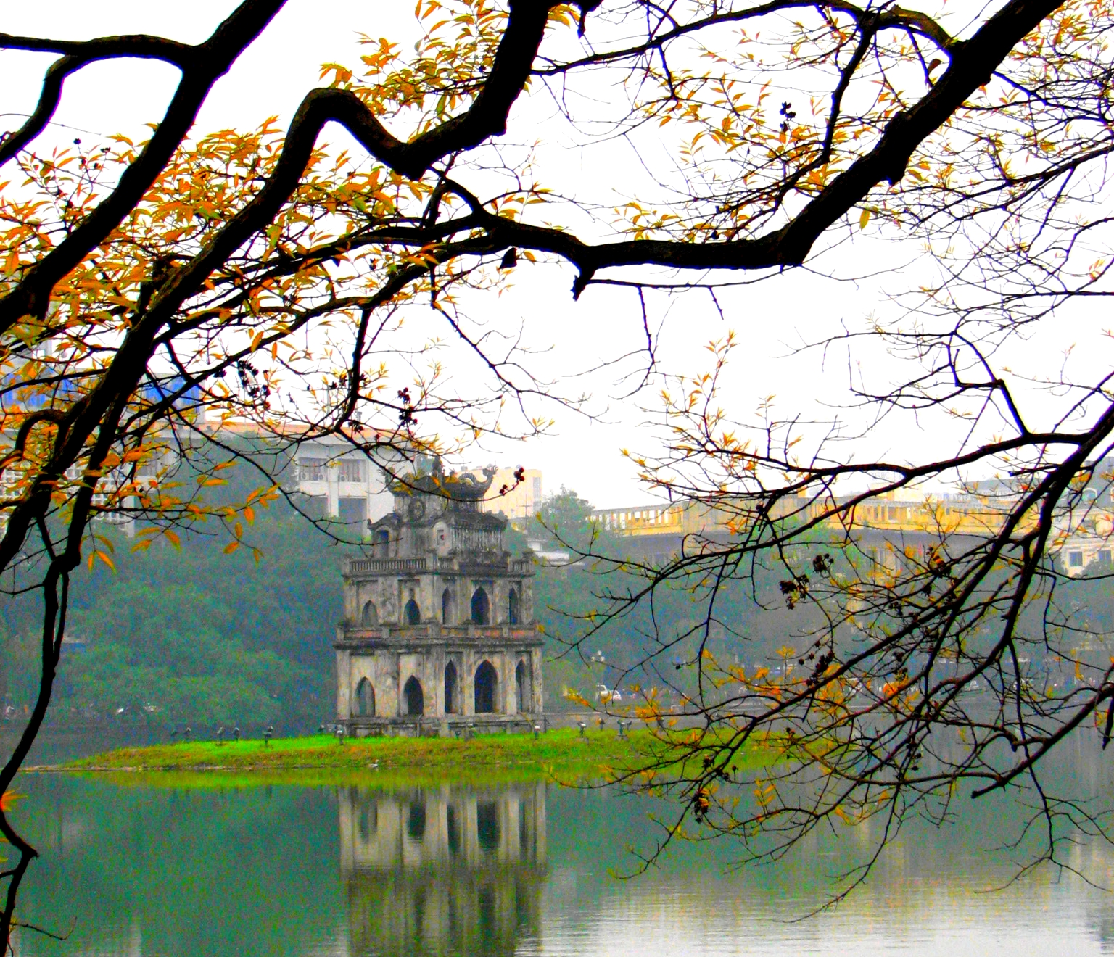
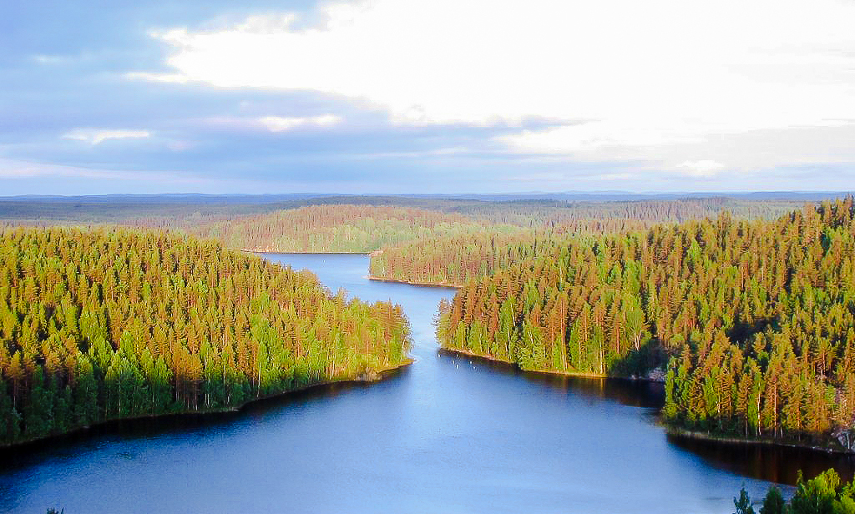
SIMILARITIES AND DIFFERENCES
VIETNAM
FINLAND

Slide 3
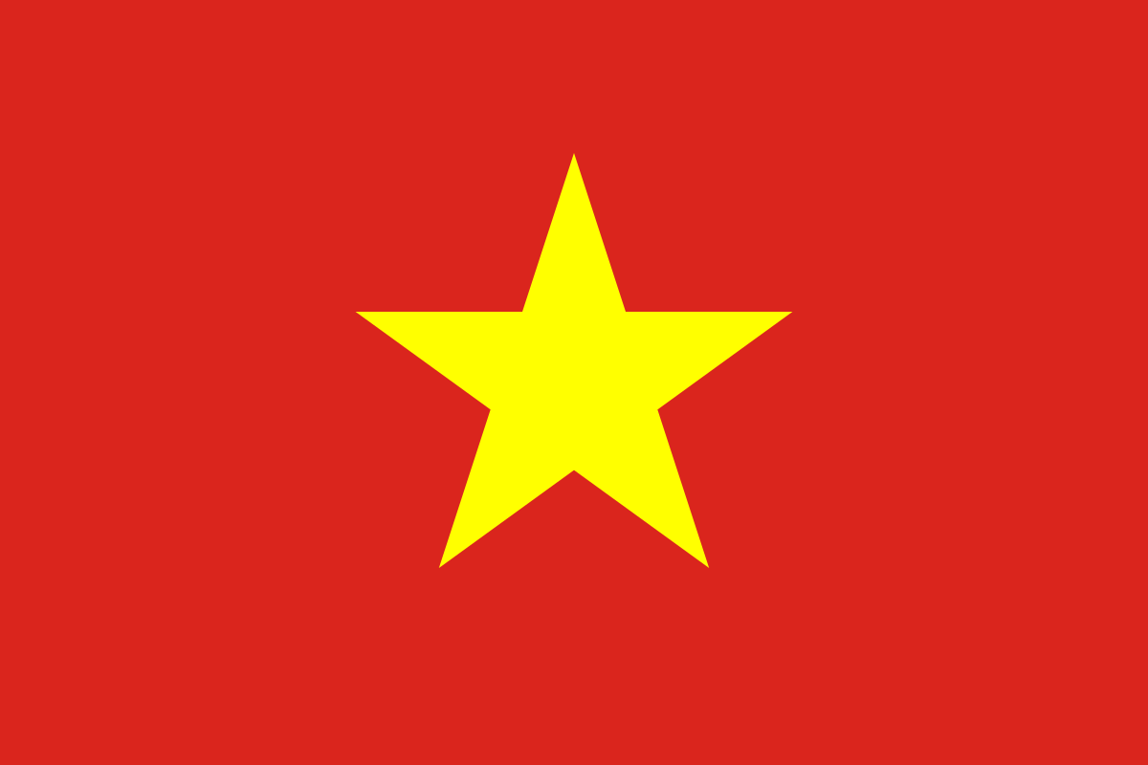
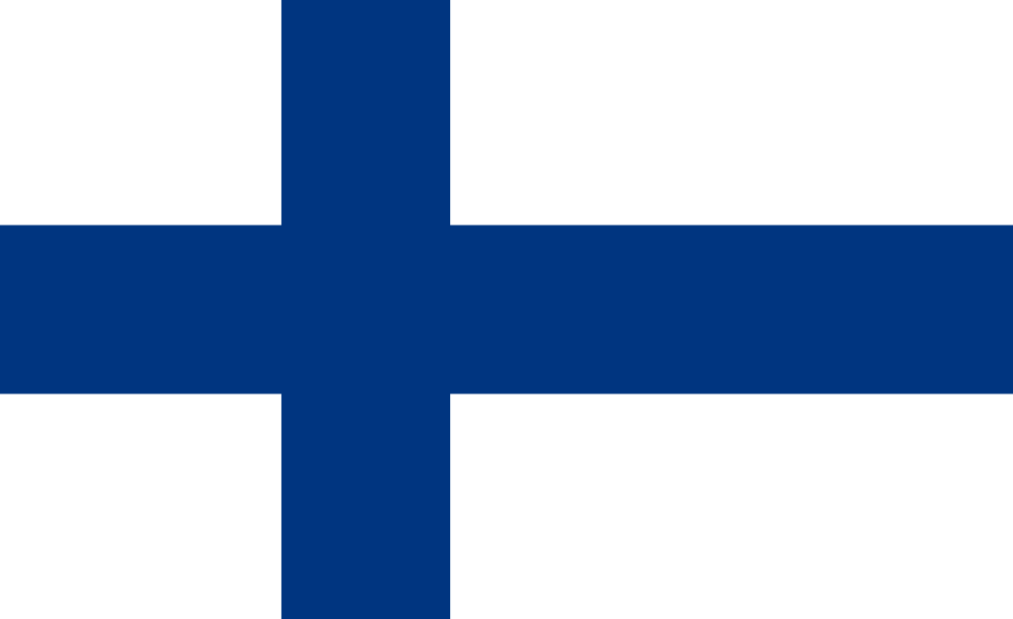
FLAG
VIETNAM
FINLAND

Slide 4
LANGUAGE
SIMILARITIES : + Have a language for speaking and writing + Use alphabet
DIFFERENCES:
VIETNAM
FINLAND
- Use Vietnamese
- Use Finnish

Slide 5
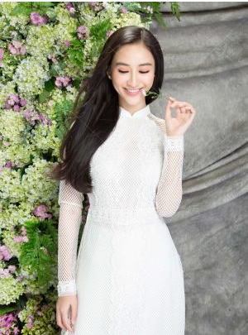
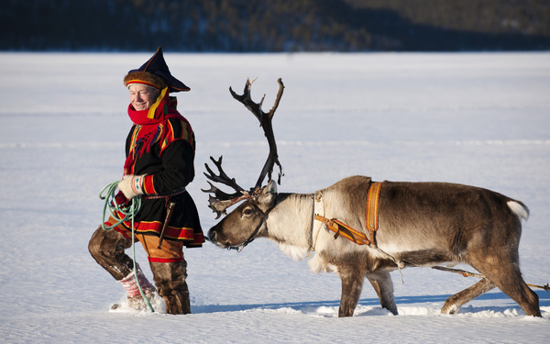
Culture
DIFFERENCES:
VIETNAM
FINLAND
Religion: Buddhism
Traditional clothes: Ao dai
Holiday: Nation Day, Lunar New Year,
Religion: Christianity
Traditional clothes: Kolt
Holiday: Christmas, May Day, Juhannus

Slide 6
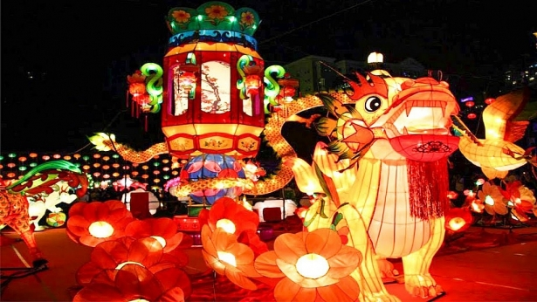
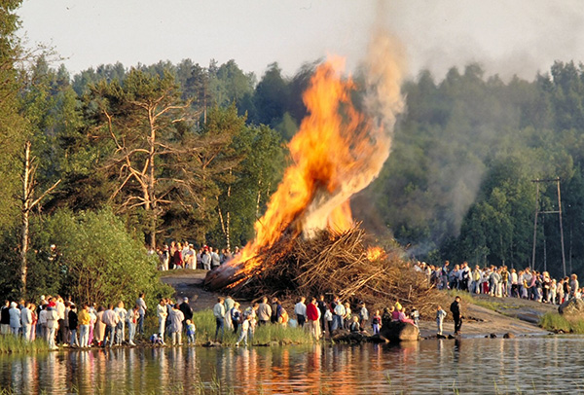
VIETNAM
FINLAND
Mid-Autumn Festival
JUHANNUS (Mid-summer)
Hold on: late September to early October
Hold on: last weekend of June

Slide 7
Food
SIMILARITIES : + 3 main meals
DIFFERENCES:
VIETNAM
FINLAND
The main meal is rice
Hunting wild animals doesn’t allow
Example: Sizzling pancake, Pho, moon cake,...
Use much meat
Meat of wild animals can eat
Example: Glögi( wine) , Salmakki( candy) , Beer,...

Slide 8
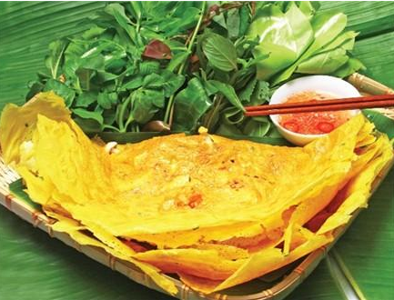
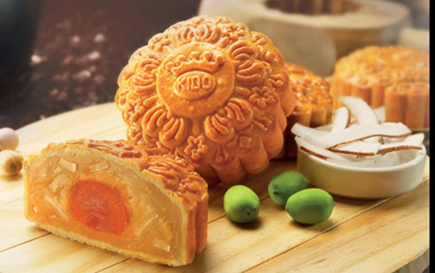
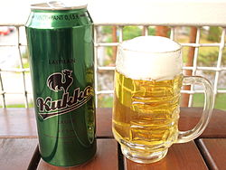
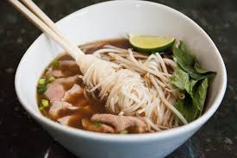
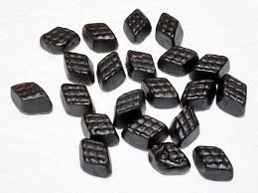
VIETNAM
FINLAND
Glögi
Sizzling pancake
Moon cake
Beer in Finland
Pho
Salmiakki

Slide 9
THANKS FOR WATCHING

